Slide 1
Forecasting Future
08.02.2021 | Kirill Shurshev

Slide 2
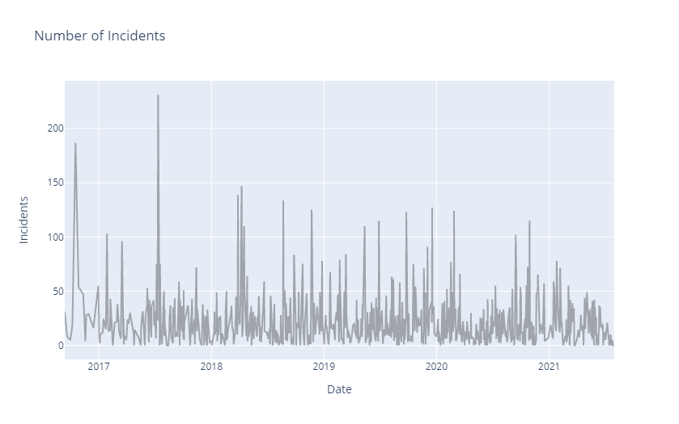
Dataset
First 20 values
Entered on | value
9/12/2016 | 31
9/14/2016 | 24
9/20/2016 | 8
9/30/2016 | 5
10/7/2016 | 19
10/17/2016 | 187
10/26/2016 | 55
10/27/2016 | 54
11/11/2016 | 47
11/16/2016 | 9
11/18/2016 | 4
11/21/2016 | 28
11/29/2016 | 29
12/14/2016 | 16
12/30/2016 | 55
1/2/2017 | 9
1/4/2017 | 2
1/5/2017 | 10
1/13/2017 | 12
1/16/2017 | 25
1/17/2017 | 23
Incidents from 2016/09/12 until 2021/07/30
Arranged to average value

Slide 3
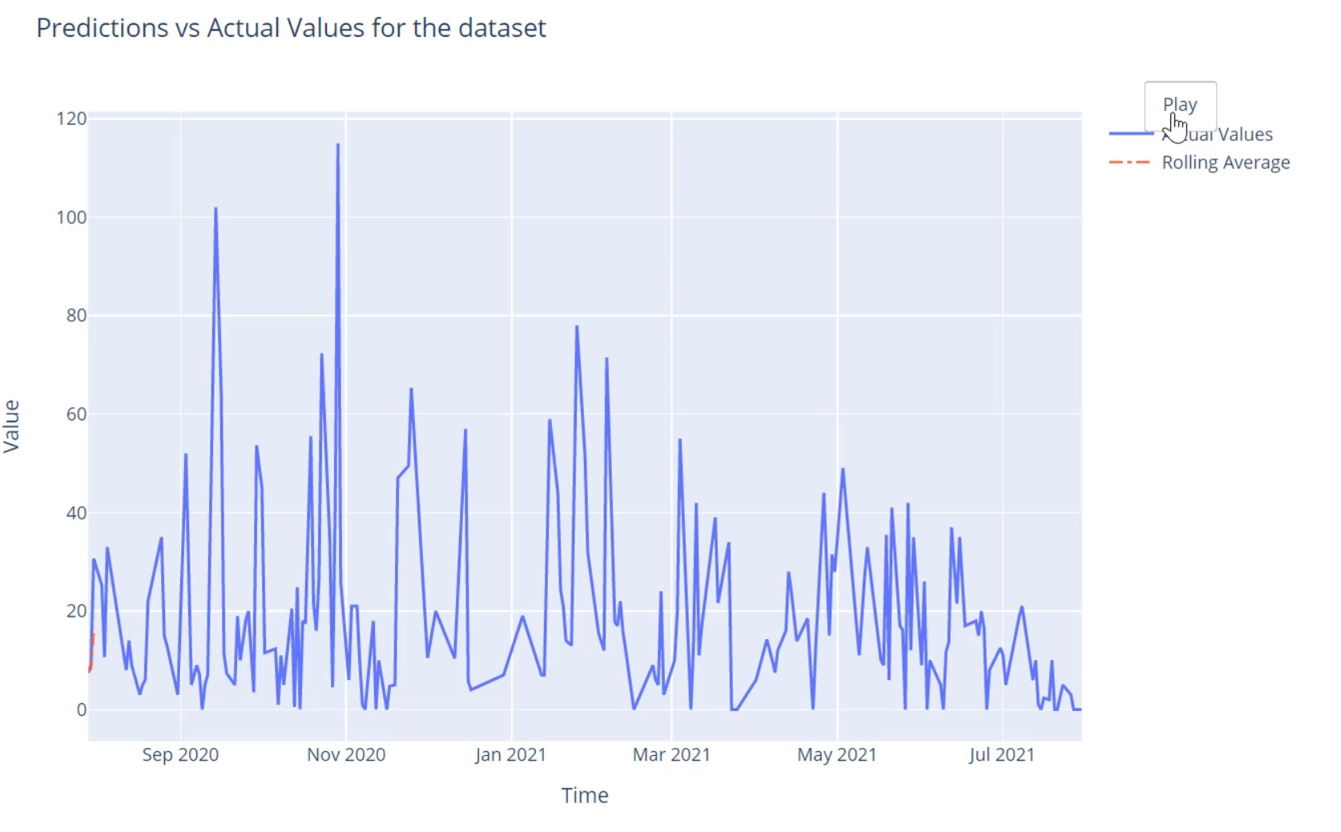


Rolling Average
Commonly used to smoothen the model and predict the expected value
For example: the first group of two numbers in the series will be summed up and divided by two. The result will be calculated. That iteration will happen with all numbers in the series.
Thus, we get a smooth line
Pros: simple implementation
Cons: low precision

Slide 4
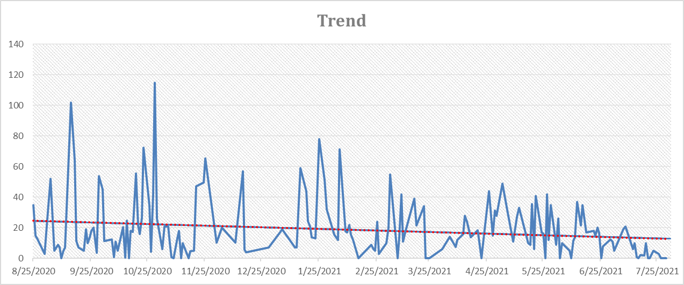
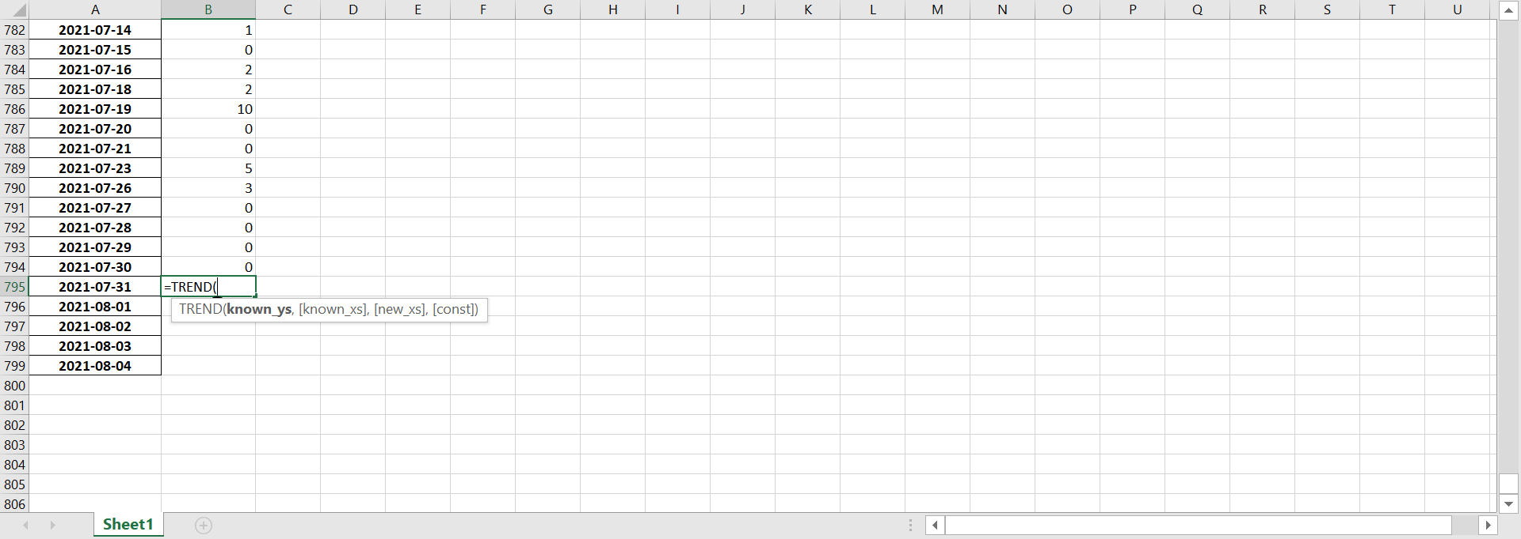
Trend Estimation
The trend estimation is made by simple linear regression. Regression is a line which lies perfectly between all point and can be extrapolated
It is easy to do in Excel with =TREND() function

Slide 5
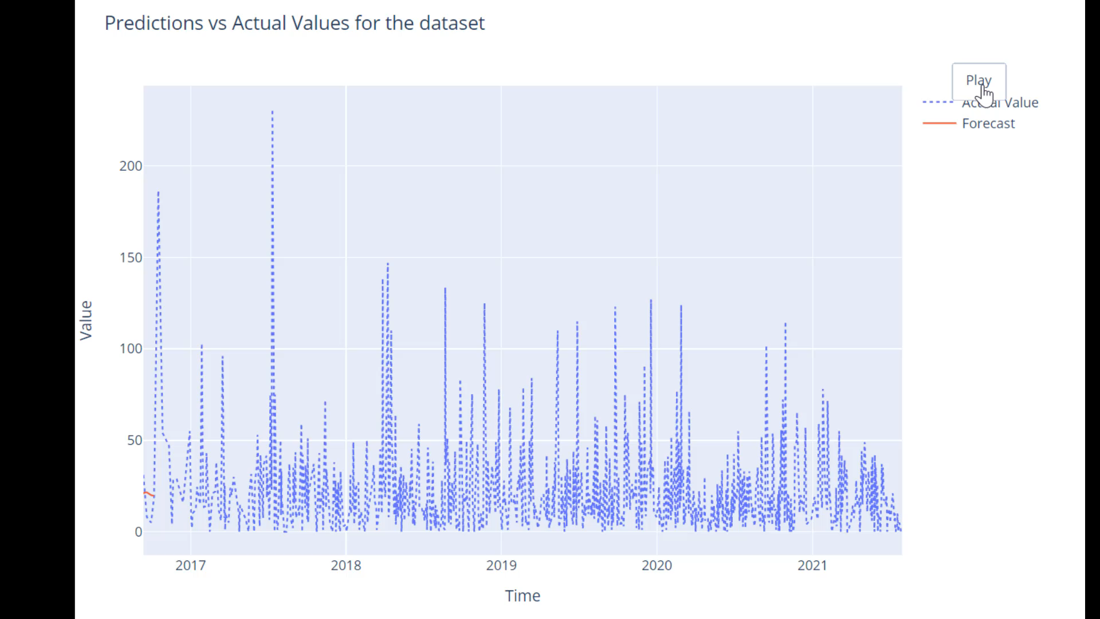
ARIMA
The most common method for time series analysis
With the combination of 3 Methods (Autoregression, Integration, Moving Average) allows to make excellent forecasting
Pros: precise, consider seasonal components
Cons: hard to optimize hyperparameters for dataset and to automatically forecast future values, requires stationarity

Slide 6
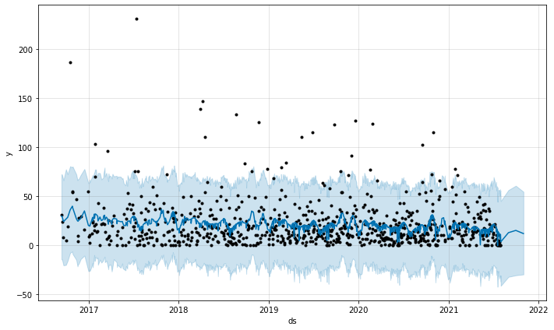
Facebook Prophet
A great tool made by Facebook to predict future values
Considers seasonal and trend components in data
Pros: easy to implement, adaptive for dataset, imbedded prediction function
Cons: requires transformations

Slide 7
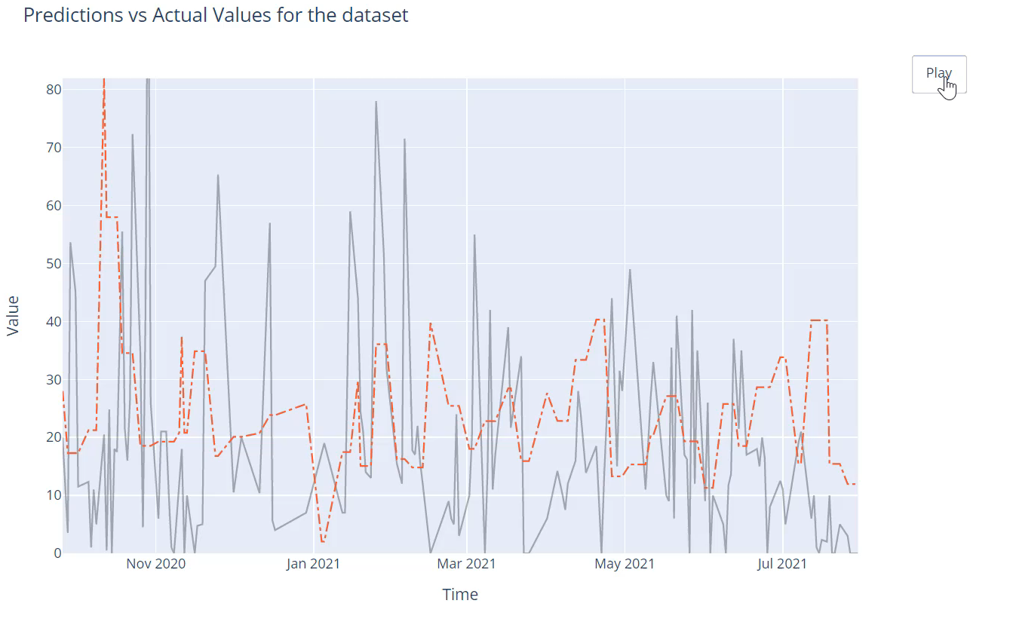
Recurrent Neural Network
There are 3 common models: LSTM, Vanilla RNN, GRU
In this example were used LSTM. It stays for “long-short term memory”. LSTM can process the entire sequences of data. It remembers short connections between data points as well as long ones.
Pros: very precise, adaptive for dataset, mid-hard to tune hyperparameters
Cons: needs feature engineering, calculation powers, high understanding threshold

